Slide 1

Secure Pipeline For Machine Learning With Homomorphic Encryption
Group Members
Muhammad Abubakar (19P-0027)
Muhammad Javed Iqbal (19P-0088)
Tahawar Ihsan (19P-0097)
Project Supervisor
Dr. Muhammad Amin

Slide 2

Introduction
Secure machine learning is a method that enables precise data analysis while preserving the security of individual data contributors.
Secure machine learning involves developing and implementing machine learning models that are resistant to attacks and ensure the confidentiality, integrity, and availability of the data and models used.

Slide 3
Problem Statement
Machine learning algorithms often require access to large datasets that may contain personal, financial, or medical information, which can be vulnerable to attacks by hackers, cybercriminals, or other malicious actors.

Slide 4



Security Techniques
Differential Privacy
Homomorphic Encryption
Federated Learning

Slide 5
Homomorphic Encryption Techniques
Partially Homomorphic Encryption
Fully Homomorphic Encryption

Slide 6
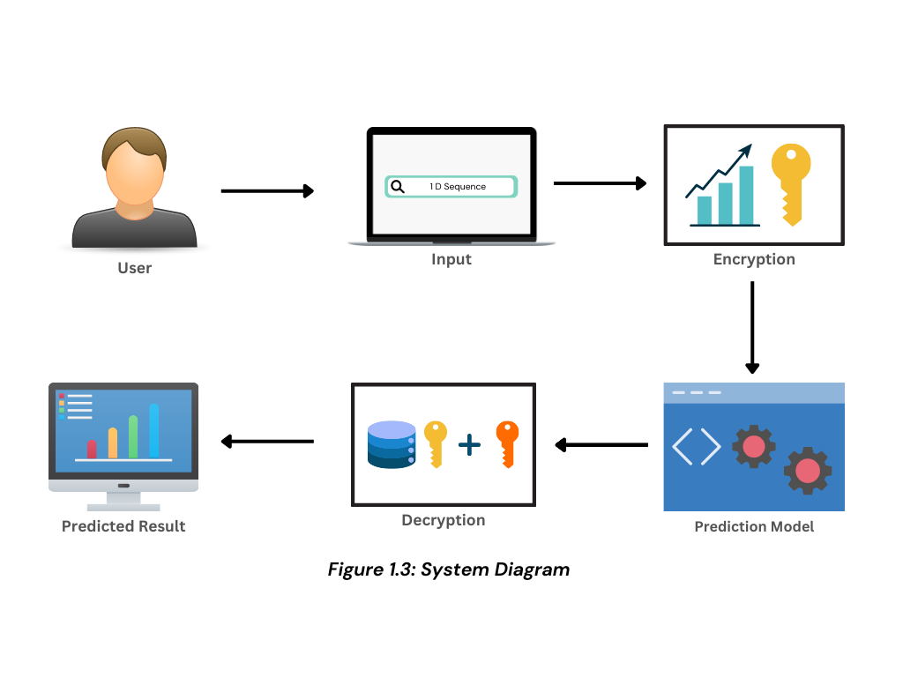
Flow Diagram

Slide 7
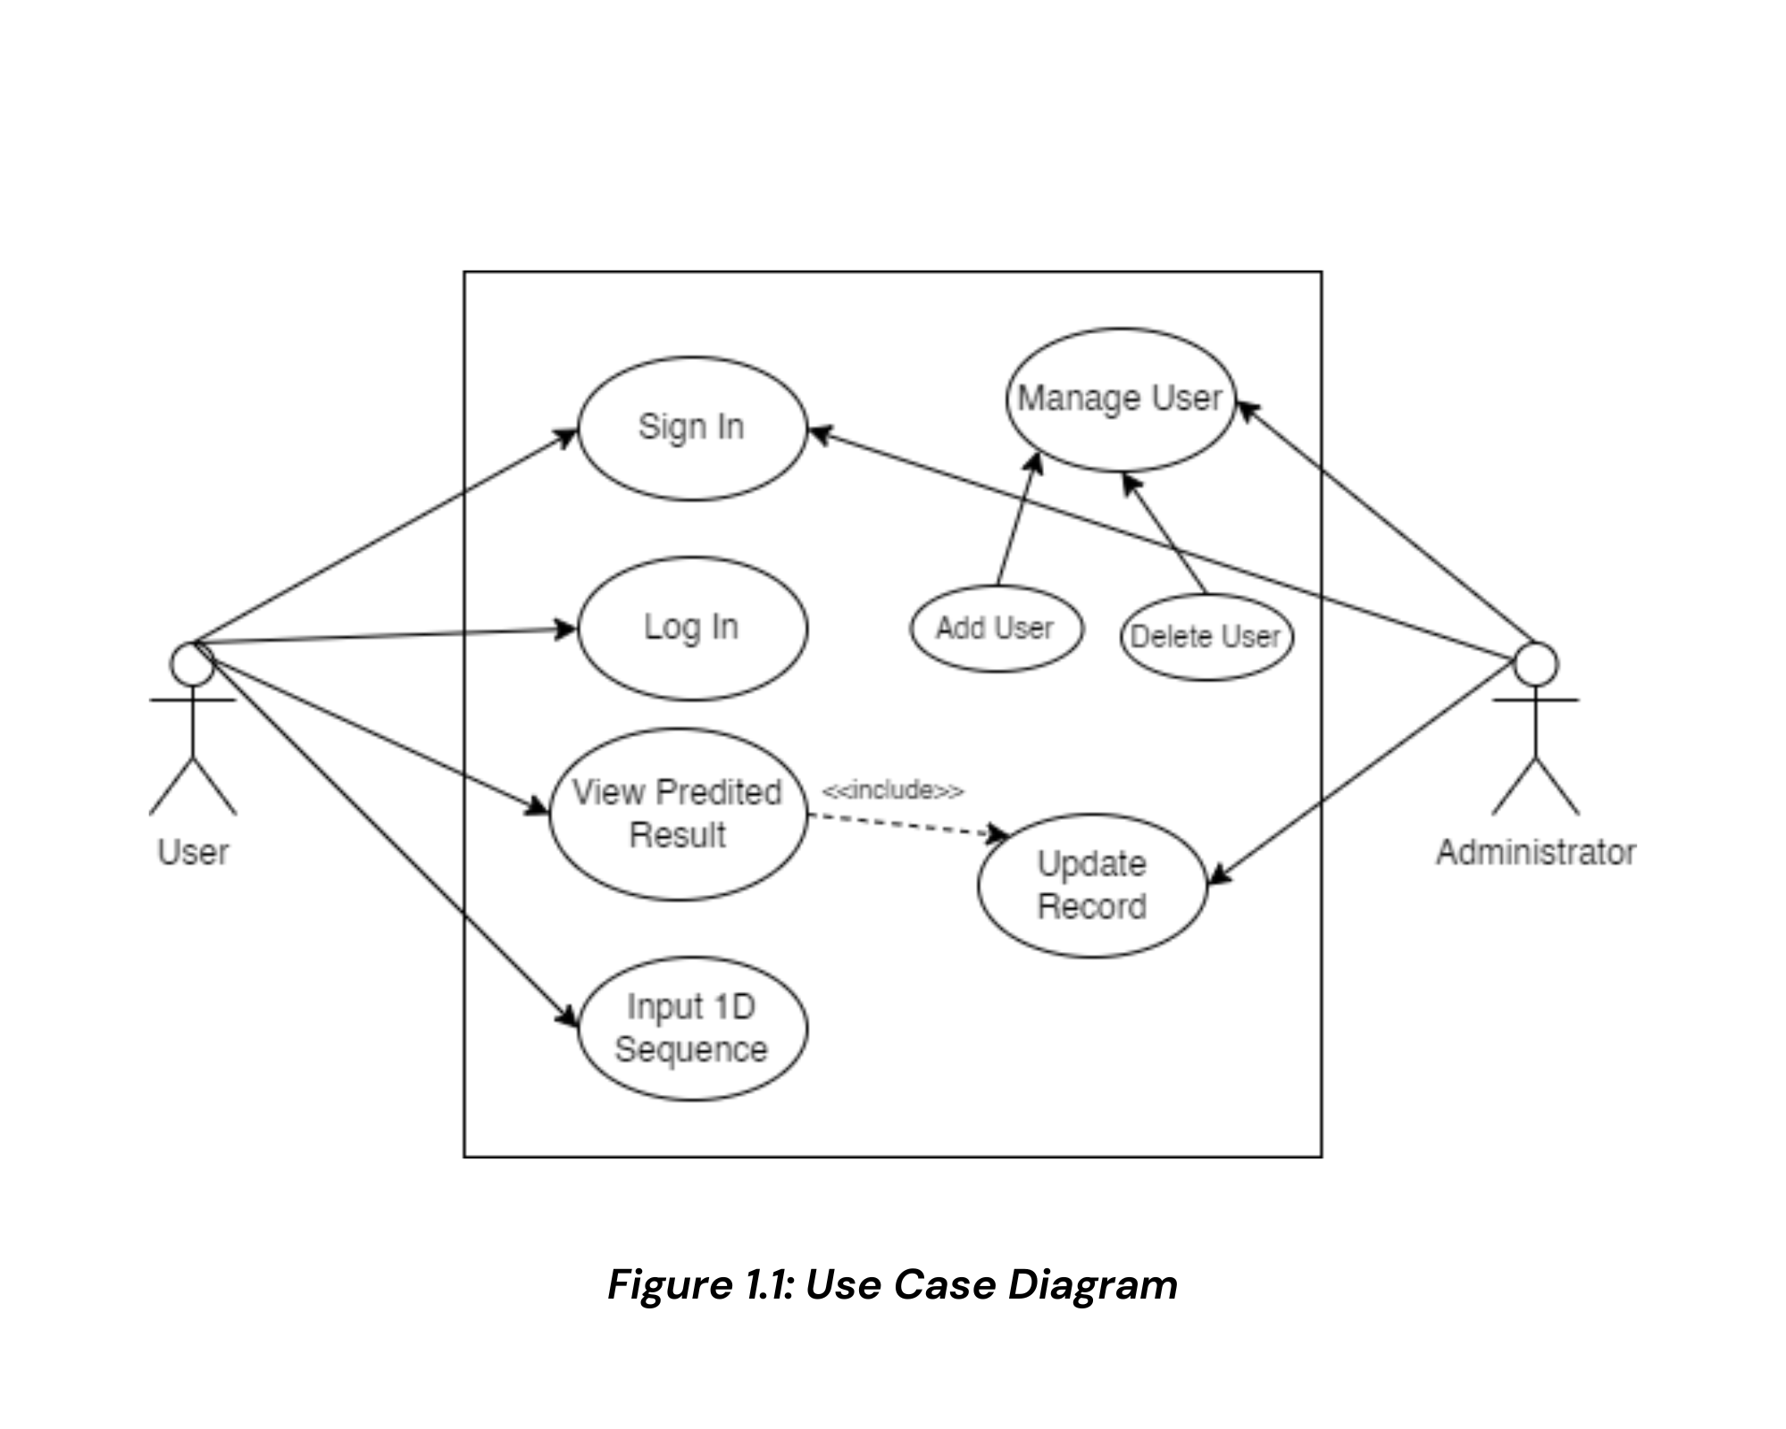
Use Case Diagram

Slide 8
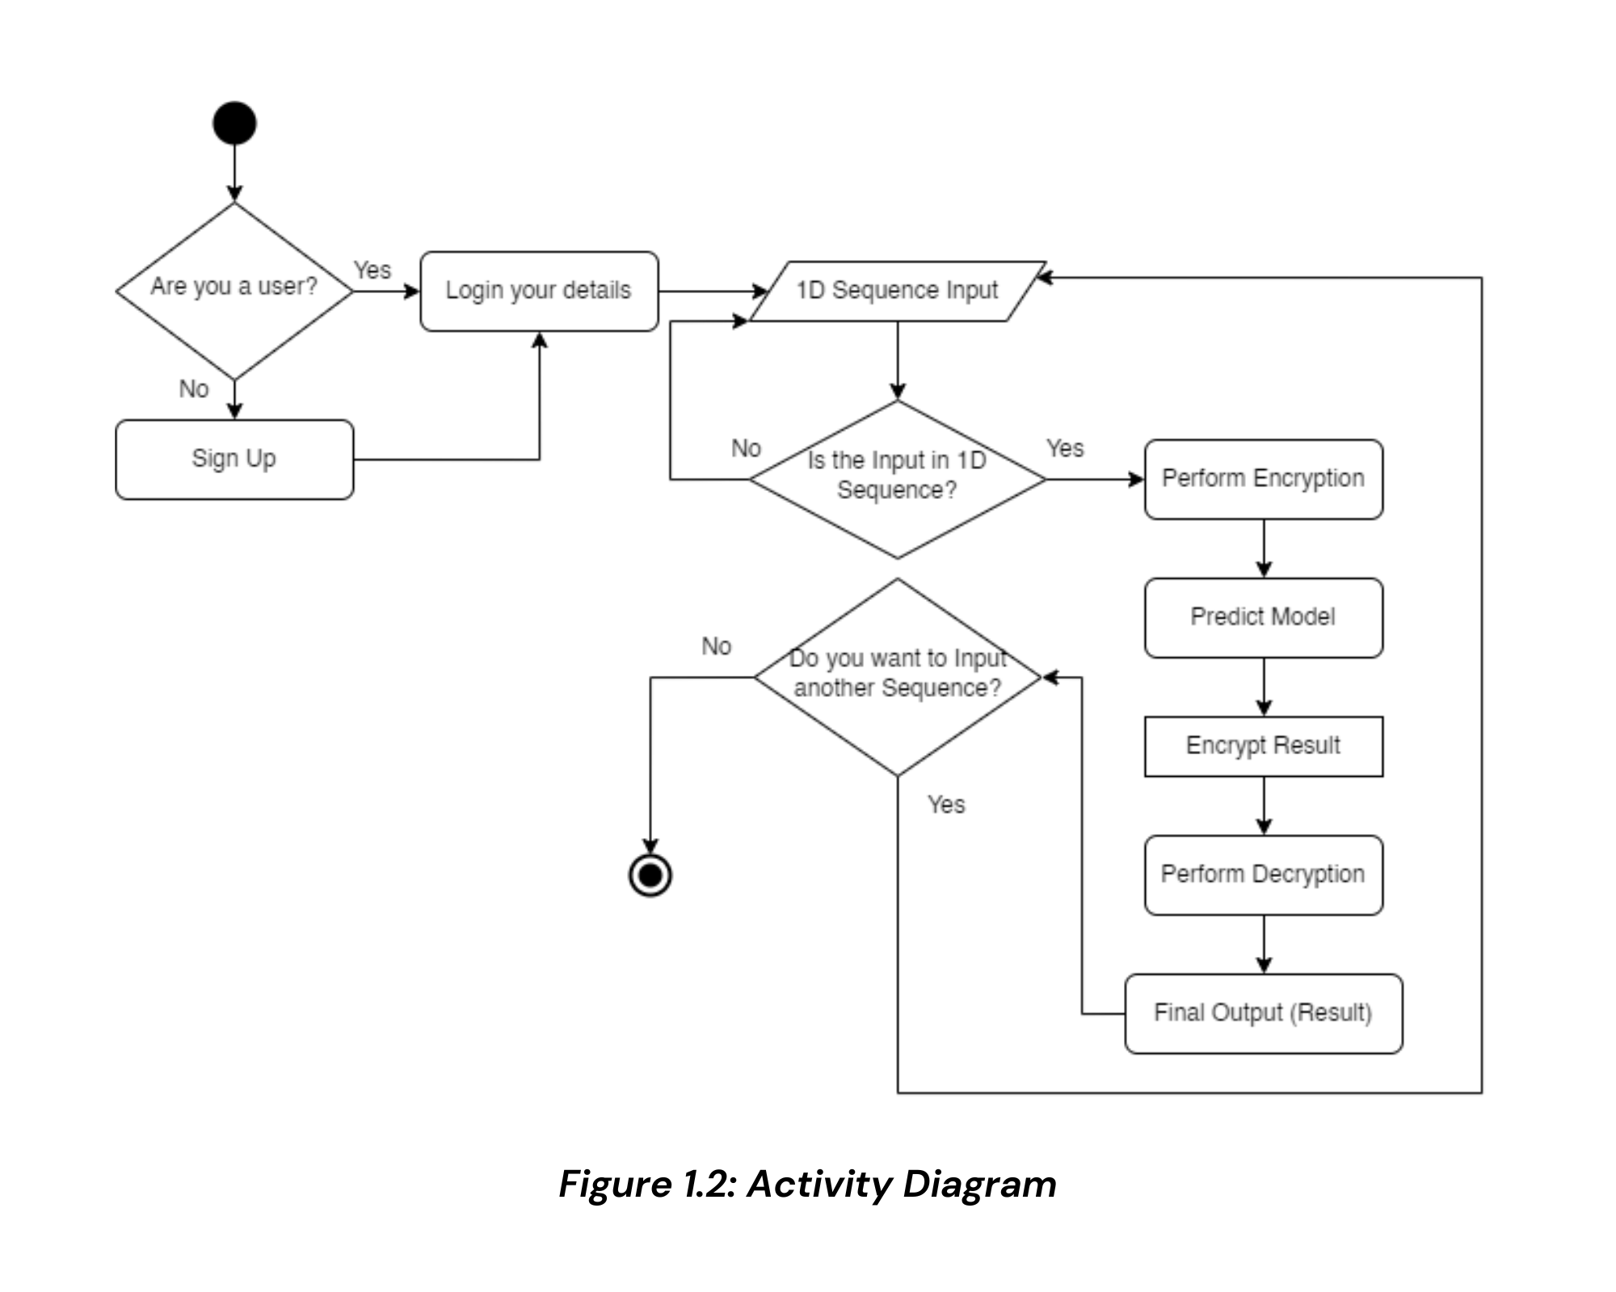
Activity Diagram

Slide 9

Objectives
Protecting sensitive data
Enhancing privacy
Improving security
Enabling more data sharing

Slide 10

Tools Used
TensorFlow
Jupyter notebook
Python
React JS
MongoDB

Slide 11
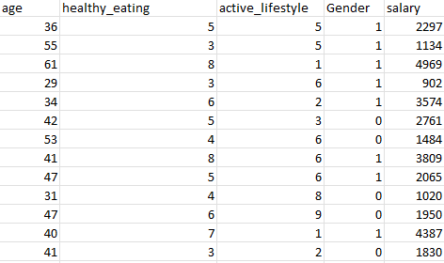
Employee Salary Dataset

Slide 12
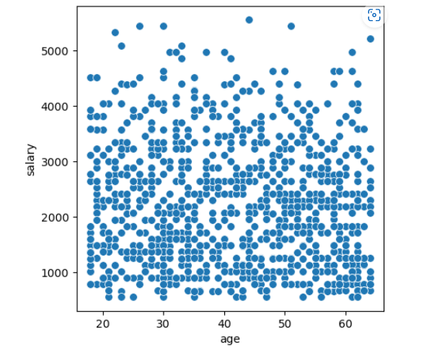
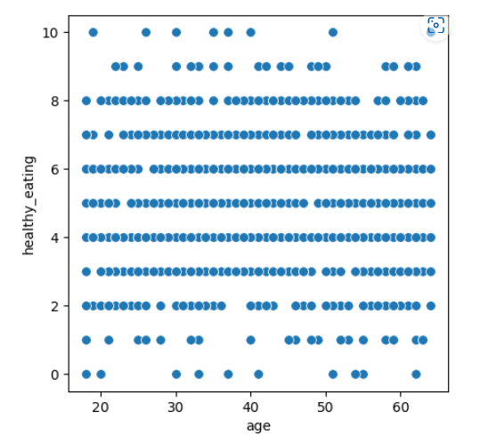
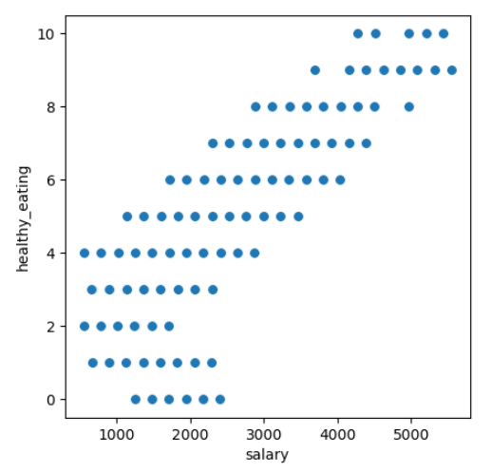
Employee Salary Dataset
Data Wrangling
Exploratory Data Analysis

Slide 13
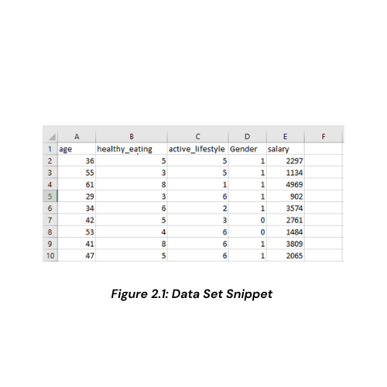
Data Set Snippet
Employee Salary Dataset

Slide 14
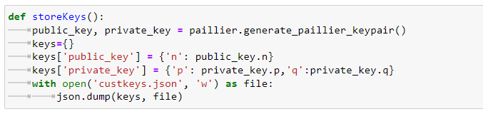
key Pair Generation
public and private key generation

Slide 15
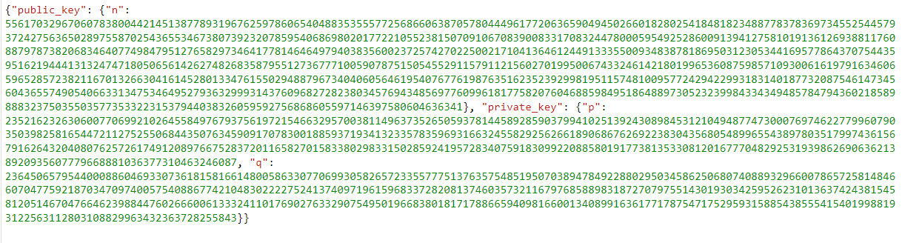

Slide 16
Algorithms
Logistic Regression
GaussianNB
Decision Trees
Random Forest

Slide 17
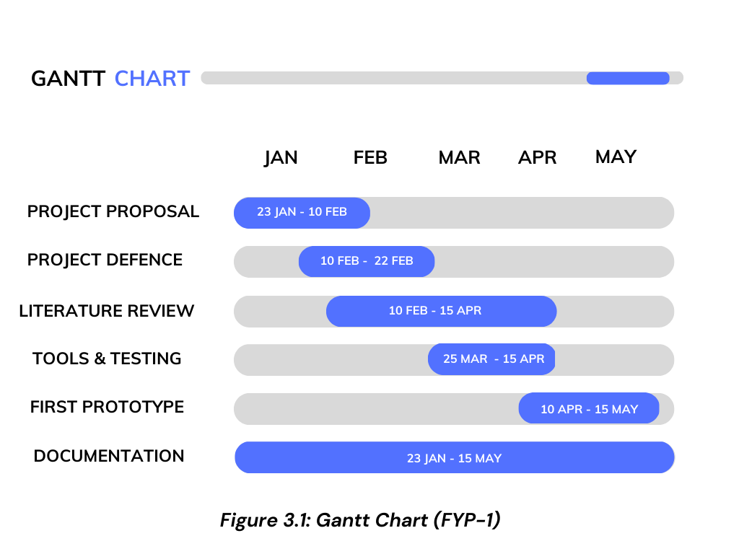

Slide 18
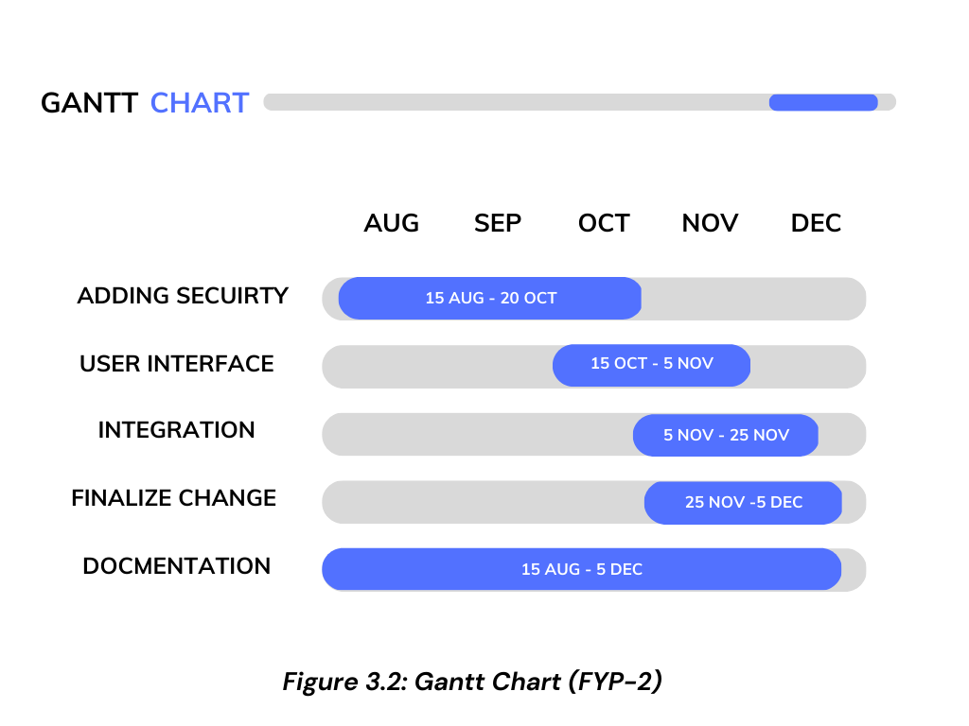

Slide 19
Team Work
Task Assigned To
Project Proposal Abubakar, Javed, Tahawar
Proposal Defence Abubakar, Javed, Tahawar
Literature Review Tahawar
System Diagram Abubakar, Javed
UML Diagrams Abubakar, Javed, Tahawar
Tools Testing Abubakar, Javed, Tahawar
Documentation Abubakar
Front End Development Javed
Back End Development Abubakar, Tahawar

Slide 20
References
[1]. Basu, Priyam, et al. "Benchmarking differential privacy and federated learning for bert models." arXiv preprint arXiv:2106.13973 (2021).
[2]. Öksüz, Abdullah Çağlar, Erman Ayday, and Uğur Güdükbay. "Privacy-preserving and robust watermarking on sequential genome data using belief propagation and local differential privacy." Bioinformatics 37.17 (2021): 2668-2674.
[3]. Qu, Chen, et al. "Natural language understanding with privacy-preserving bert." Proceedings of the 30th ACM International Conference on Information & Knowledge Management. 2021.
[4]. Hoory, Shlomo, et al. "Learning and evaluating a differentially private pre-trained language model." Findings of the Association for Computational Linguistics: EMNLP 2021. 2021.
[5]Sarkar, Esha, et al. "Privacy-preserving cancer type prediction with homomorphic encryption." Scientific reports 13.1 (2023): 1661.
[6]. Zhou, Xingyu, and Jian Tan. "Local differential privacy for bayesian optimization." Proceedings of the AAAI Conference on Artificial Intelligence. Vol. 35. No. 12. 2021.

Slide 21
Thank you!

